Slide 1

Your past, your present and your future

Slide 2
Overview
Idea
Technologies
Competitors
Costs
Team
Planification
Demo
Piloting plan

Slide 3
IDEA
What is Capsulefy?

Slide 4





Time capsule

Slide 5


Deadman switch
ON

Slide 6




Teamwork
Skills
Profitable work
Positive feedback

Slide 7
TECHNOLOGIES
What stack do we use?

Slide 8





Web app
Users and capsules
Media storage
Social networks

Slide 9


Testing
Functional and integration
Performance
Coverage

Slide 10





Slide 11
COMPETITORS
What makes us different?

Slide 12


 | Viajeros en el tiempo | Mytimecapsule | Miigen | thetimecapsule | Capsulefy
Automatic content publication
Free plan
Premium plan
Images
Videos
Social network integration
Deadman switch

Slide 13
COSTS
How much does Capsulefy cost?

Slide 14


Realistic | 29968.20 – 31330.29 €
Optimistic | 28061.13 €
Pesimistic | 34054.77 €
Project duration: 4 months

Slide 15
Project duration | 4 months
Salaries | 20.80 €/hour
Hours per month | 40
Amortization | 60 months
Equipment | 306.67 €
Hosting (1 year) | 669.34 €
Advertising (6 months) | 3060 €
Risk prevention | 10% (2724.38 €)
Total | 29968.20 €

Slide 16

Monthly advertising costs
220 €
140 €
150 €

Slide 17
TEAM
Who is behind?

Slide 18
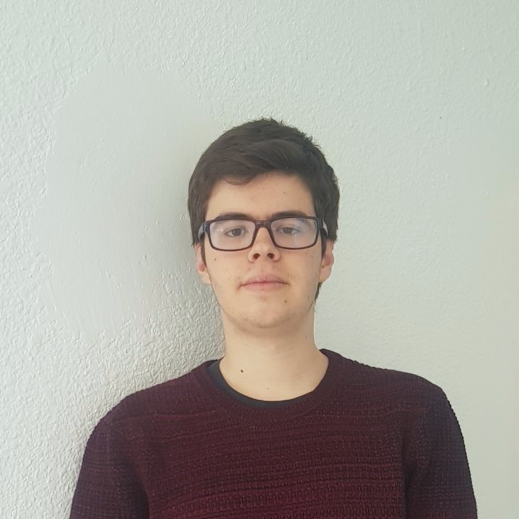
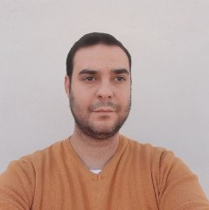




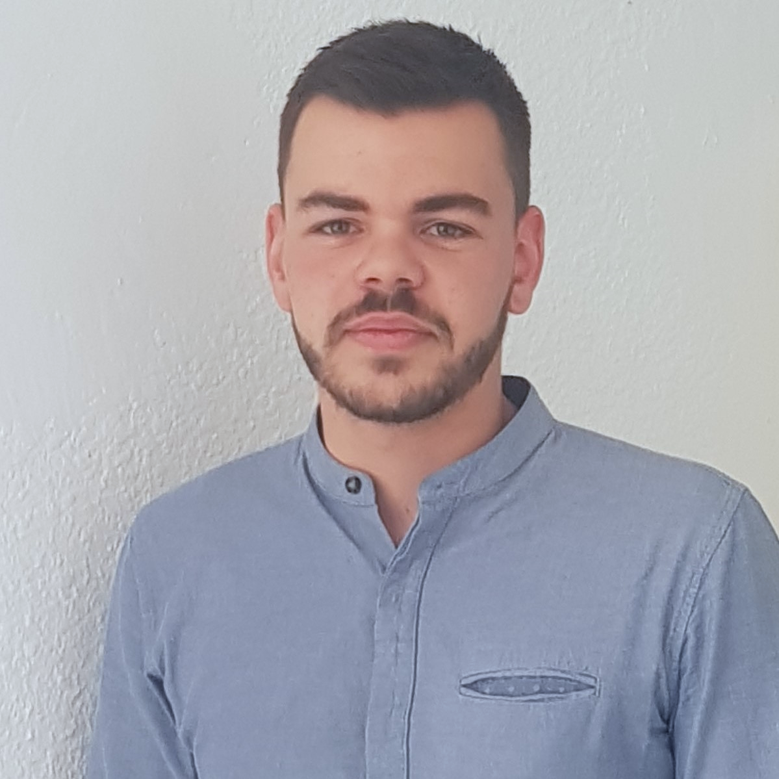
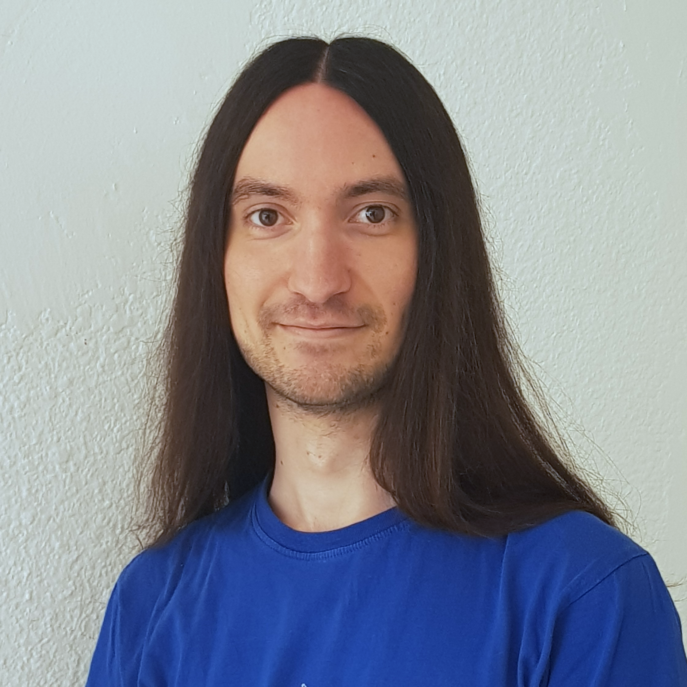


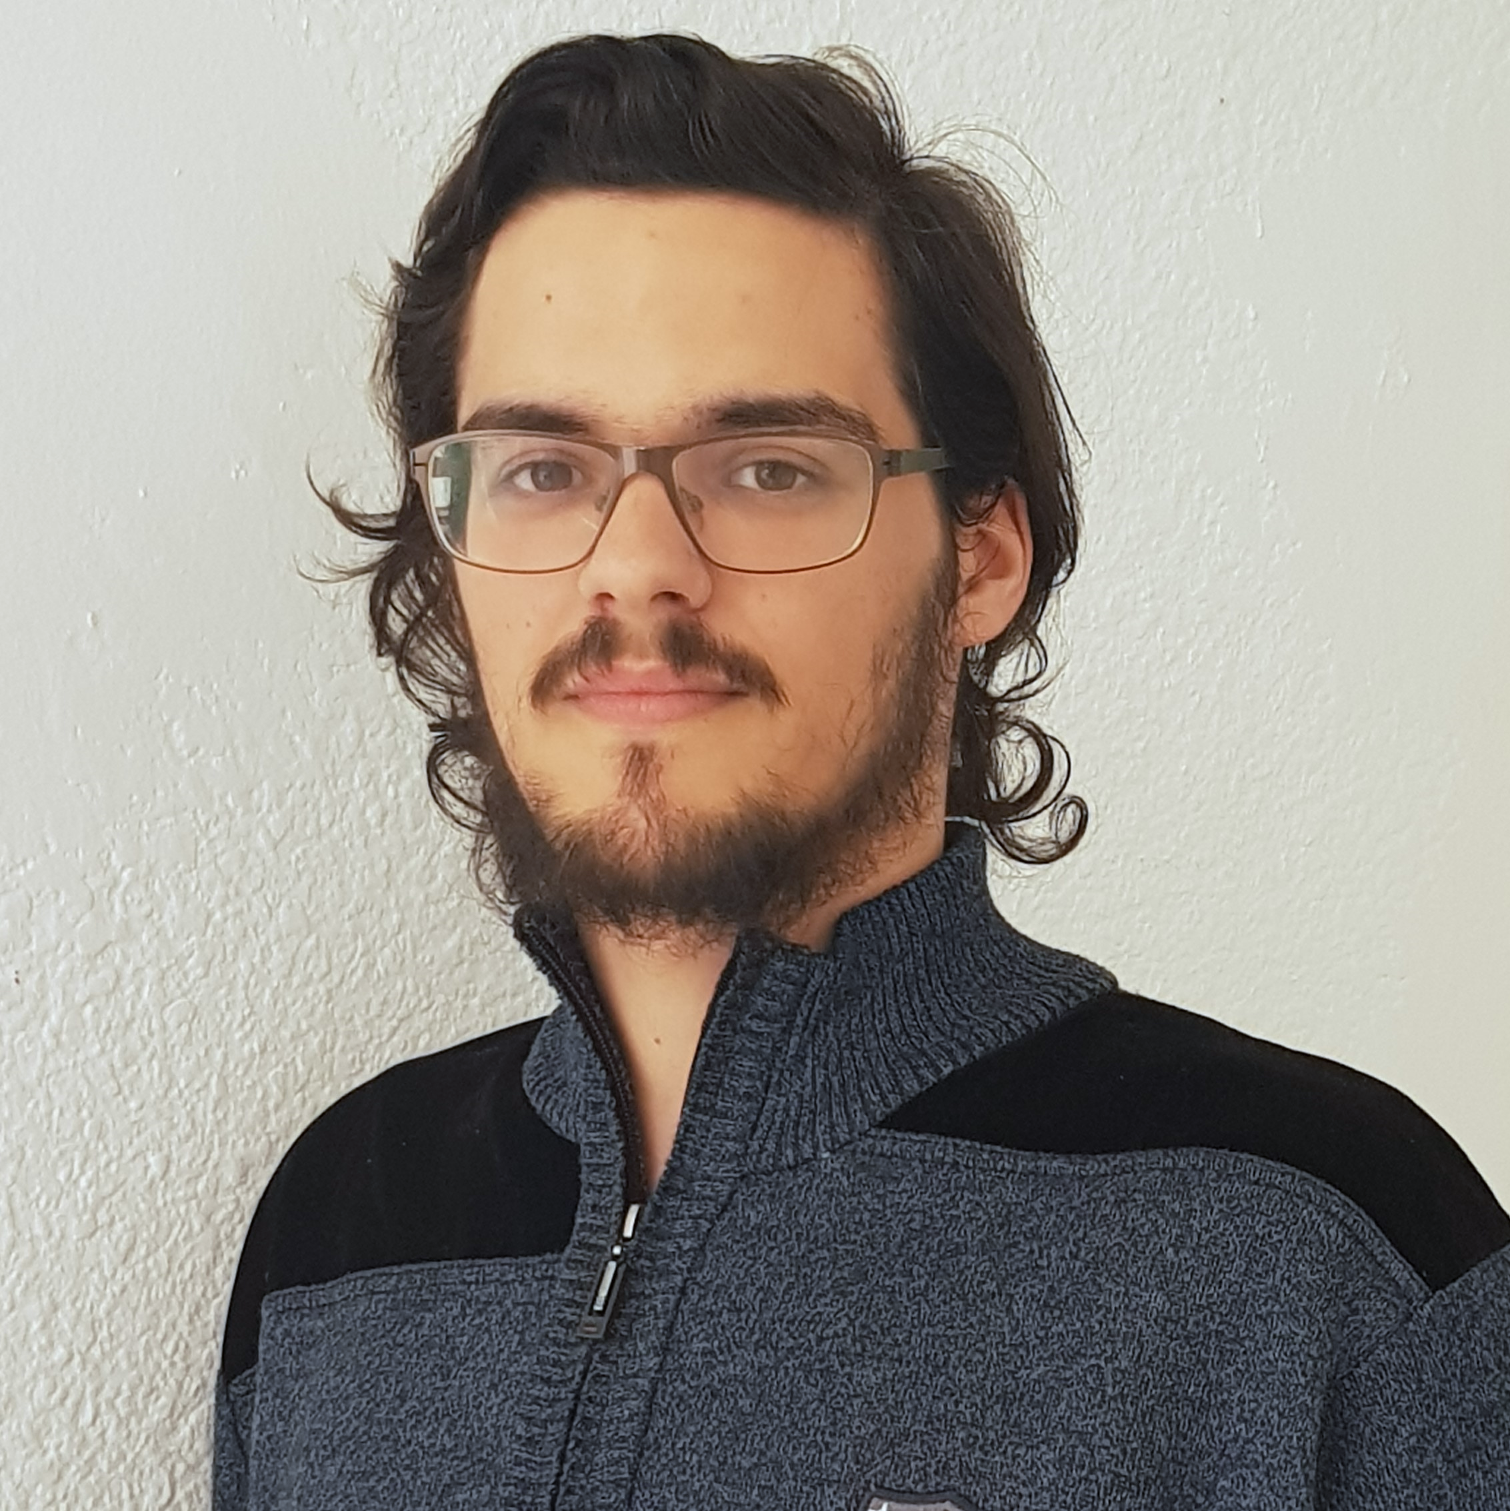



Pablo Rebollo
Project manager, backend developer
Juan Rodríguez
Requirements engineer, backend developer
Adrián Cantón
Business manager, full-stack developer
Rafael Fresno
Backend developer, API integration
Daniel Carpio
Analist,
frontend developer

Slide 19
PLANIFICATION
How do we organize development?

Slide 20
First sprint March 18th – March 29th | Core use cases Piloting plan
Second sprint April 1st – April 12th | Full MVP Feedback taken into account
Third sprint April 22nd – May 3rd | Polished MVP

Slide 21



Performance indicator
$$avg(\frac{Estimated time}{Invested time})$$
~
>= 0.5
< 0.8
>= 0.8
<= 1.2
> 1.2
<= 1.5
!
?
< 0.5
> 1.5

Slide 22



Factors affecting performance
Optimistic estimation
Wasted time
Difficulties
Pesimistic estimation
Easier tasks
Unknown technology

Slide 23



General solutions
Talk
Reschedule
Balance
Monitor

Slide 24
SPRINT 1 WEEK 1
March 18th – March 22nd

Slide 25
Task | Assignees | Est. (h) | Inv. (h) | Status
Data model | Adrián, Daniel | 4 | 1.5 | Finished
Set up environment | All | 2.5 | 2.5 | Finished
Angular research | Daniel | 1 | 2 | Aborted
Data model implementation | Juan | 2.5 | 2 | Finished
Populate database | Pablo | 2 | 3.2 | Finished
Basic capsule CRUD | Rafael | 2.5 | 9 | To be tested
Display capsules | Adrián | 2 | 5 | To be tested
TIME

Slide 26
Task | Assignees | Est. (h) | Inv. (h) | Status
Listing capsules | Juan | 1.5 | 1 | To be tested
User login | Juan | 1 | 1 | To be tested
Advertisement budget | Pablo | 1.5 | 1.5 | Finished
User interface | Daniel | 1 | 10 | Finished
Documentation | Daniel, Adrián, Juan | 1.5 | 1.5 | Finished
Presentation | Pablo, Rafael | 3 | 4 | Finished
Review meeting | All | 2.5 | 2.5 | Finished
TIME

Slide 27
Performance
Adrián | 1.34
Daniel | 1.05
Rafael | 0.67
Pablo | 0.84
Juan | 1.06

Slide 28



What went wrong?
No Angular knowledge
Bad estimations
Lack of time

Slide 29
What actions were taken?
Meet
Reschedule
Reestimate
How do we know that they worked?
Week 2 performance indicators

Slide 30
SPRINT 1 WEEK 2
March 25th – March 29th

Slide 31
Task | Assignees | Est. (h) | Inv. (h) | Status
Feedback meeting | All | 5 | 5 | Finished
Travis CI set up | Adrián, Rafael | 2 | 3 | Finished
Modular capsules | Adrián | 5 | 4.5 | Finished
Private capsules | Juan | 2 | 1.5 | Finished
Email automation | Juan | 2 | 1.5 | Finished
Search capsules | Daniel | 1.5 | 1 | Finished
List own capsules | Juan | 1 | 1 | Finished
Pagination | Juan | 1 | 3 | Finished
TIME

Slide 32
Task | Assignees | Est. (h) | Inv. (h) | Status
Deadman switch | Pablo | 4 | 5 | Finished
Social network integration | Rafael | 4 | 1 | Postponed
User interface | Daniel | 4 | 7 | Finished
Piloting plan | Adrián | 2.5 | 1 | Finished
Sprint meeting | All | 5 | 5 | Finished
Documentation | Adrián, Daniel, Juan | 1.5 | 1.5 | Finished
Presentation | Rafael | 3 | 5.5 | Finished
Deliverable | Pablo | 3 | 4 | Finished
TIME

Slide 33
Performance
Adrián | 1.32
Daniel | 1.03
Rafael | 0.60
Pablo | 0.77
Juan | 0.87

Slide 34


What went wrong?
Performance further reduced
Implementation differences
Lack of time

Slide 35
What actions were taken?
Meet
Reschedule
Reestimate
How do we know that they worked?
Sprint 2 performance indicators

Slide 36
Total performance
Adrián | 1.31
Daniel | 1.02
Rafael | 0.63
Pablo | 0.80
Juan | 0.96

Slide 37


Lessons learnt: organization
Too many core use cases
Bad estimations
Lack of coordination
Dependencies

Slide 38


Lessons learnt: technologies
Unknown technlogies
Low code quality
Implementation differences
Deployment problems

Slide 39



Taken actions
Detailed planning
Time for documentation
Better tool usage
Divide tasks

Slide 40
SPRINT 1 RESULTS
What was produced?

Slide 41
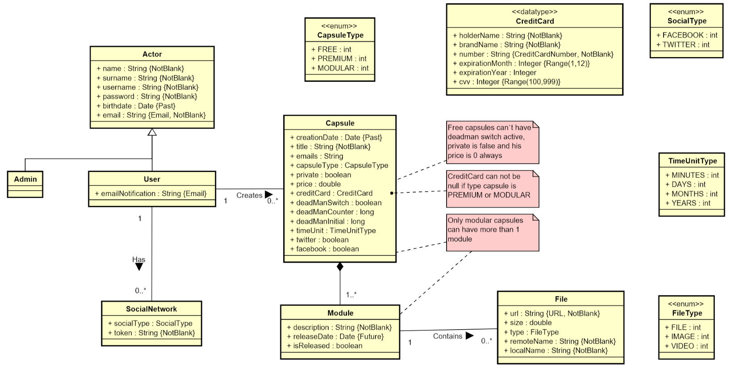
Conceptual model

Slide 42
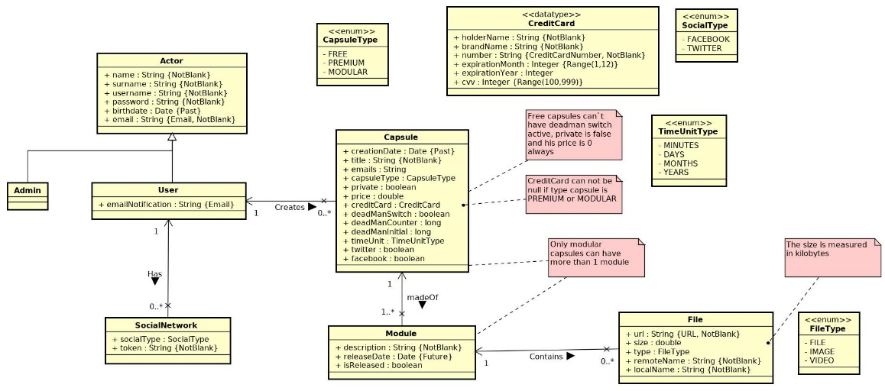
UML diagram

Slide 43
Documentation
Sprint 1 documentation
Piloting plan
Development
Frozen app: https://capsulefy02.herokuapp.com
GitHub release: https://github.com/pabreblob/capsulefy/releases

Slide 44
Project duration | 7 weeks (2 development)
Salaries | 20.80 €/hour
Hours per month | 40
Total salaries | 6989 €
Amortization | 60 months
Equipment | 134.16 €
Hosting | 0 €
Advertising | 0 €
Total | 7123.16 €

Slide 45
DEMO
How does the system look like?

Slide 46
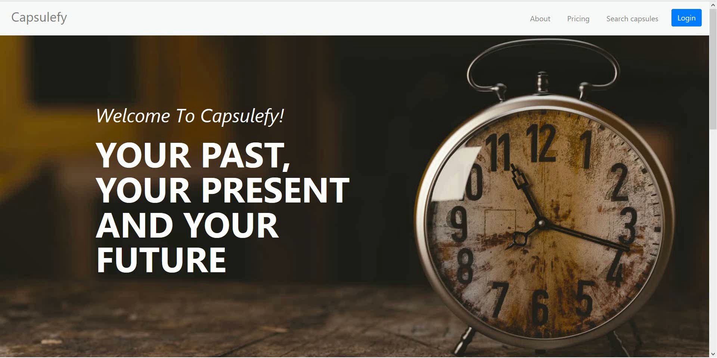
No logged user – List, search and display capsules

Slide 47
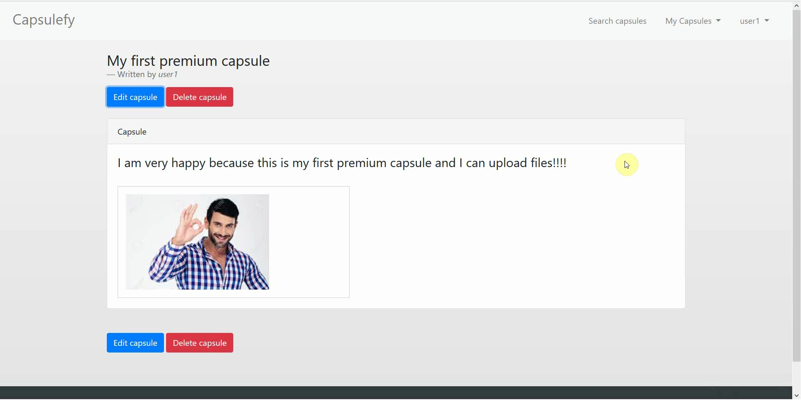
Logged-in user – Create premium capsule

Slide 48
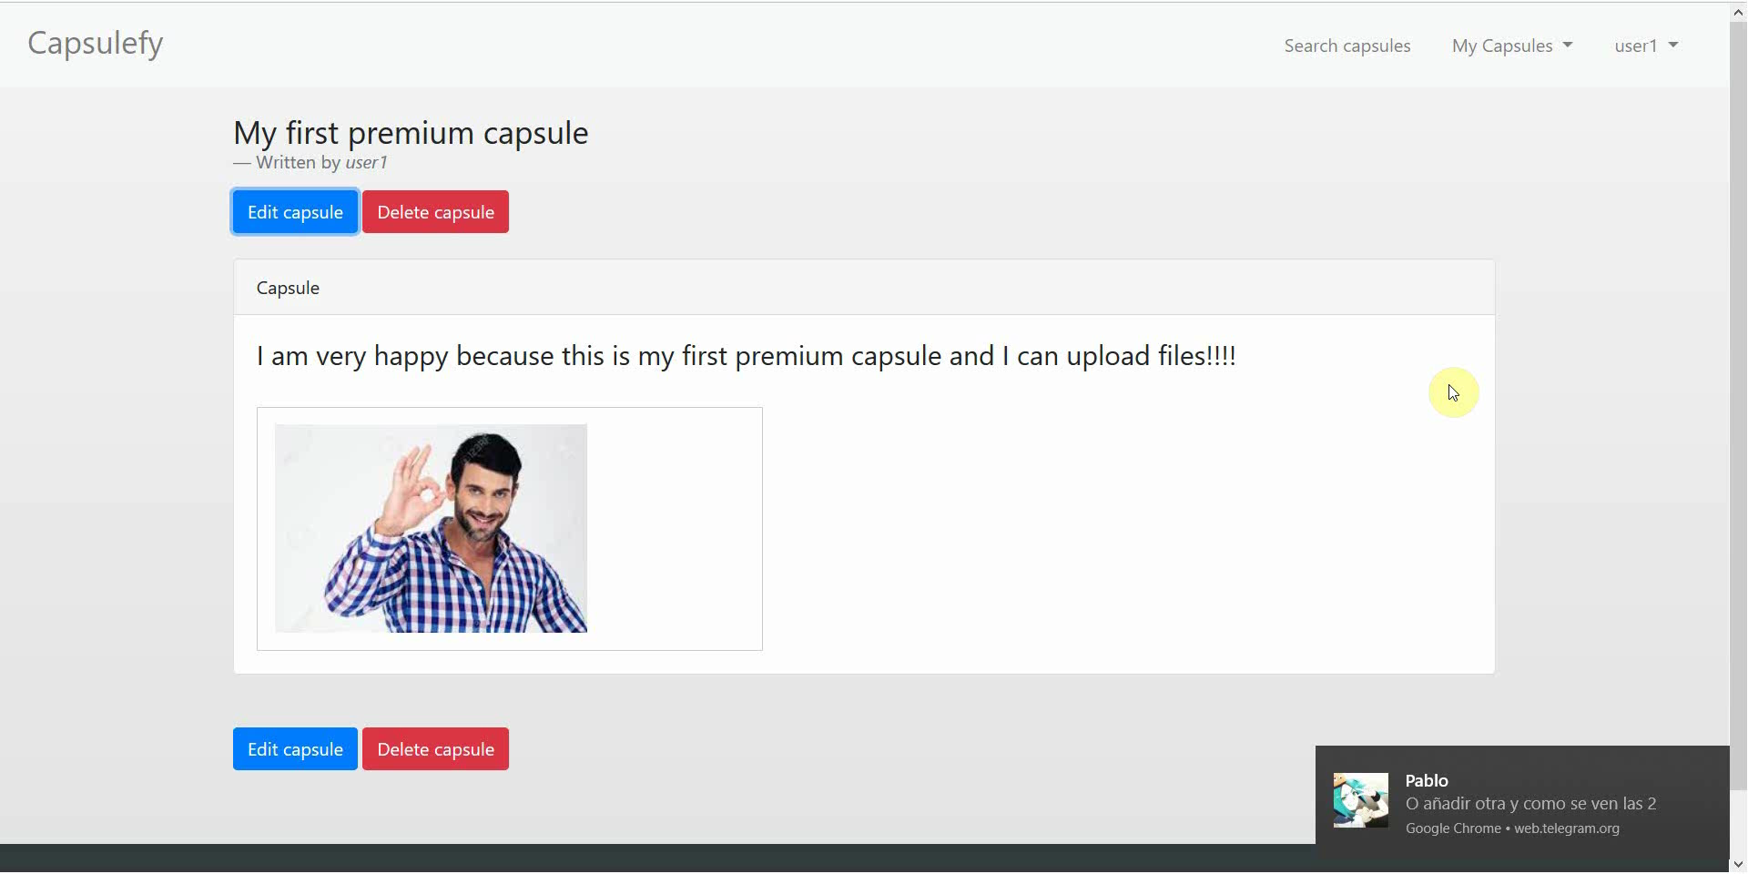
Logged-in user – Create premium capsule

Slide 49
SPRINT 2 WEEK 1
April 1st – April 7hth

Slide 50
Task | Assignees | Start | End | Est. (h)
Initial meeting | All | Apr 1 | Apr 1 | 1.5
Local settings | Daniel | Apr 2 | Apr 2 | 1
User registration | Juan | Apr 2 | Apr 2 | 2
Remove expired capsules | Pablo | Apr 2 | Apr 2 | 1.5
Twitter integration | Rafael | Apr 2 | Apr 4 | 4
Research payment options | Adrián | Apr 2 | Apr 4 | 2
Fix pagination issues | Daniel, Juan | Apr 3 | Apr 3 | 3
DM switch notifications | Pablo | Apr 3 | Apr 4 | 1.5
TIME

Slide 51
Task | Assignees | Start | End | Est. (h)
User interface | Daniel | Apr 4 | Apr 7 | 5
Ban users | Juan | Apr 4 | Apr 6 | 2
Automation improvements | Pablo | Apr 4 | Apr 7 | 4
Basic payment | Adrián | Apr 5 | Apr 7 | 4
Presentation | Rafael | Apr 5 | Apr 6 | 3
Pilot users feedback | Adrián | Apr 6 | Apr 6 | 1
Rehearsal | Pablo | Apr 7 | Apr 7 | 1.5
TIME

Slide 52
SPRINT 2 WEEK 2
April 8th – April 12th

Slide 53
Task | Assignees | Start | End | Est. (h)
Feedback meeting | All | Apr 8 | Apr 8 | 1.5
User interface | Daniel | Apr 9 | Apr 11 | 7
Facebook integration | Rafael | Apr 9 | Apr 11 | 4
Premium payments | Adrián | Apr 9 | Apr 10 | 4
Admin dashboard | Juan | Apr 9 | Apr 10 | 3
Jmeter performance tests | Pablo | Apr 9 | Apr 11 | 4
SonarCloud set up | Adrián | Apr 11 | Apr 12 | 3
Edit notification email | Juan | Apr 11 | Apr 11 | 2
TIME

Slide 54
Task | Assignees | Start | End | Est. (h)
Sprint review Sprint 3 planification | All | Apr 11 | Apr 11 | 1.5
Presentation | Rafael | Apr 11 | Apr 12 | 3
Deliverable | Pablo | Apr 11 | Apr 12 | 4
TIME

Slide 55
PILOTING PLAN
How will users test Capsulefy?

Slide 56


Create manual
Create test suite
Test the system
Gather feedback
Fill form

Slide 57
Sprint 2
Users receive and fill form
March 30 – April 6
Development
April 8 – April 12
Receive users feedback
April 6
Planification
April 8

Slide 58
Sprint 3
Easter Week
Users receive and fill form
April 12 – April 22
Development
April 22 – May 3
Receive users feedback
April 22
Planification
April 22

Slide 59
After development
Users receive and fill form
May 4 – May 12
Receive users feedback
May 12
Planification
May 13

Slide 60
Documentation
Manual (PDF)
Test suite
All core use cases
Form
https://forms.gle/DWs2JPuyyd8hnbjg6

Slide 61
Thanks!
Upstream release: https://capsulefy.herokuapp.com
Sprint 1 release: https://capsulefy02.herokuapp.com
Contact email: capsulefy.communications@gmail.com
Pilot users form: https://forms.gle/DWs2JPuyyd8hnbjg6
Original mockups: https://marvelapp.com/4395g15/screen/53795517

